Slide 1
Interactive Breakout Game Project
-Vishnu Duknam

Slide 2
Agenda
Introduction
System Design
Implementation
Conclusion
Future Work

Slide 3
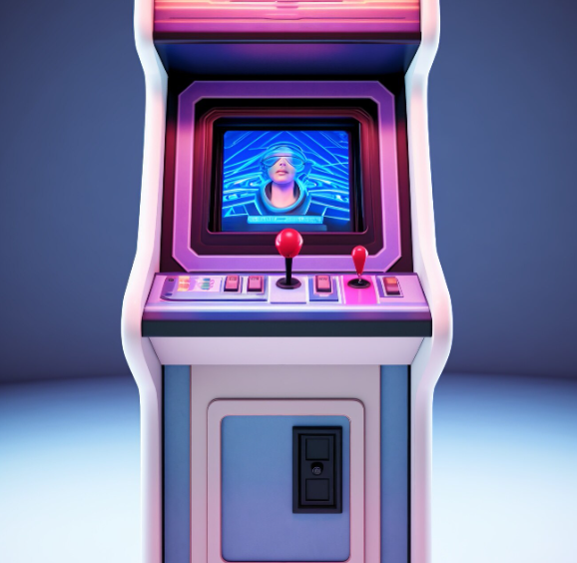
Game Introduction:
A modern take on the classic breakout game where players destroy layers of bricks by hitting them with a ball.
Aim: To clear all bricks to progress to higher levels without letting the ball fall below the paddle.
User Experience:
The game interface displays current and high scores at the top of the screen, enhancing the competitive aspect.
Visuals: Simple yet appealing graphics, with different colors for various brick layers and a smoothly moving paddle and ball.

Slide 4
System Design
Architectural Overview
The game operates on a simple loop processing user inputs, updating game state, and rendering graphics.
Utilizes the Canvas for drawing game elements dynamically.
Game Mechanics:
Detailed explanation of ball physics: How the ball's velocity changes upon hitting different objects.
Paddle mechanics: Responsive paddle movement controls using keyboard arrows

Slide 5
Implementation Tools and Challenges
Tools Used:
Setup Visual Studio Code.
Overview of web technologies: HTML for structure, CSS for styling, JavaScript for game logic, and the Canvas API for rendering.
Challenges and Solutions:
Cross-browser compatibility: Challenges faced in making the game work uniformly across different web browsers and solutions applied.
Difficulty scaling: How difficulty was calibrated across levels, ensuring a balanced progression that maintains player engagement.
Debugging practices: Discuss how bugs were identified and resolved, perhaps sharing a significant bug and the strategy used to fix it.

Slide 6
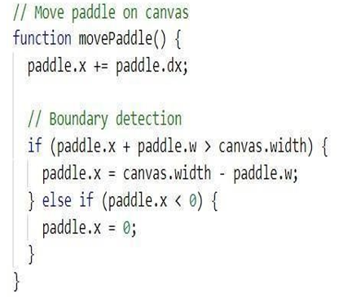
Move Paddle
When the user presses the arrow keys, the paddle on the canvas moves in the corresponding direction—left or right. The paddle continues to move until it reaches the boundary of the canvas, where it stops.

Slide 7
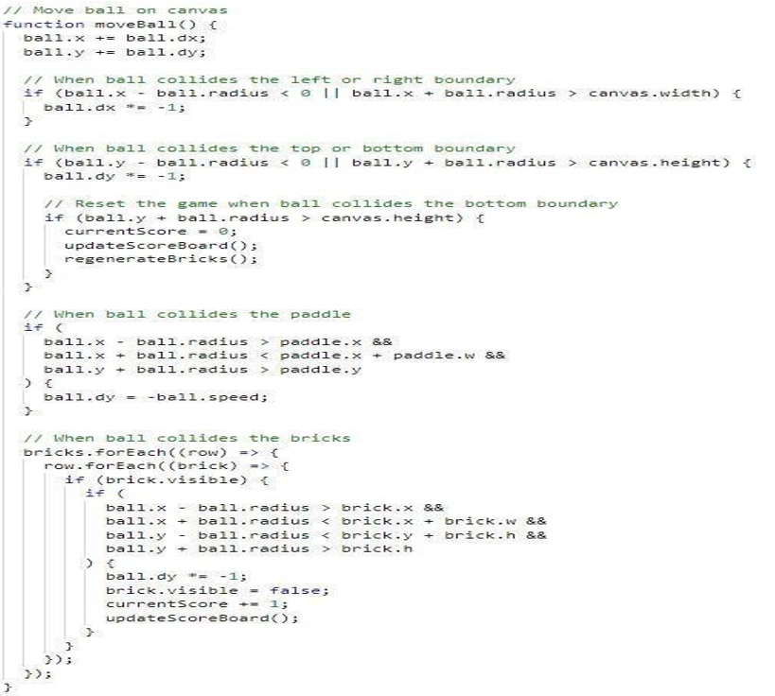
Move Ball
Ball has to move and whenever it collides with boundaries, paddle or bricks, it has to change it’s moving direction.

Slide 8
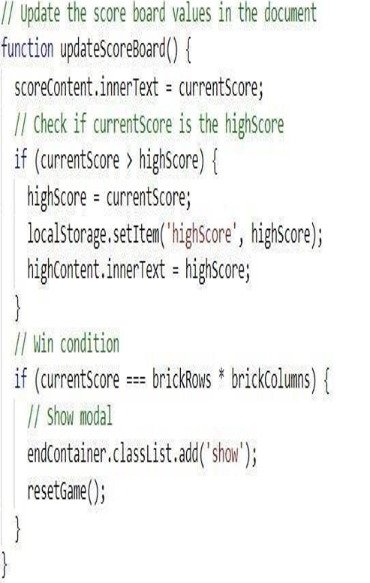
Update score board
When the ball hits a brick, the score increases by one point per brick. The game displays the high score, which is saved persistently using the browser's local storage API

Slide 9
Conclusions and Future Work
Project Impact:
Future Enhancements:
such as learning advanced JavaScript and understanding browser graphics handling.
Impact on potential users: How the game can serve educational purposes by teaching physics concepts and improving reflexes.
Adding features like power-ups, different ball types, and interactive brick behaviors (e.g., moving or regenerating bricks).
Potential for expanding to mobile platforms using responsive design principles and touch controls.
Reflection:
Reflect on team collaboration and project management: What worked well and what could be improved in future projects.

Slide 10
Thank You

